Slide 1
Late Returns of Books
What is the cause and what to do about it

Slide 2
Books are past due too often
Problems we want to address:
15% of books are returned late (customer negligence)
30+% of library records are invalid (data quality)
Questions we want to answer:
Which are the factors connected to late returns?
How can we mitigate them?
What can we do to improve library records?

Slide 3
Key Factors for Late Returns
Analysis conducted on available data shows that the most influential factors on late returns are following:
Number of Pages/Price of Books
Customer Age
Libraries
Inefficient database

Slide 4
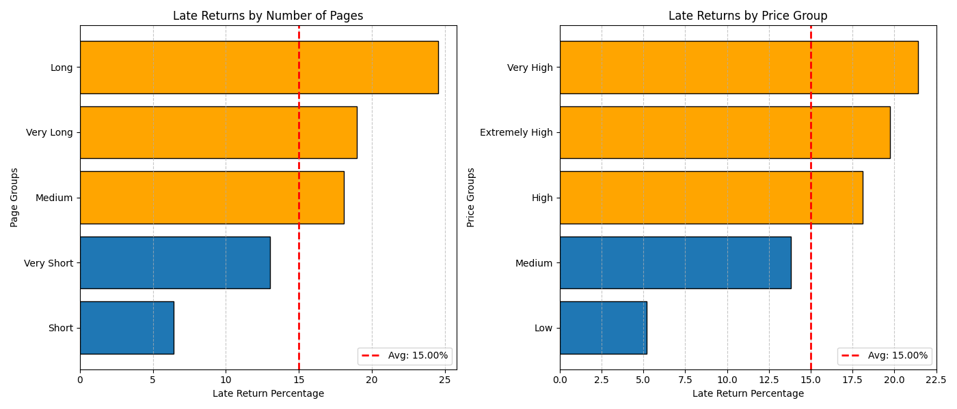
Books Length influences late returns
Books with more pages have higher than average late returns
The more pages books have, more expensive they are
Books with 450+ pages are returned late more often

Slide 5
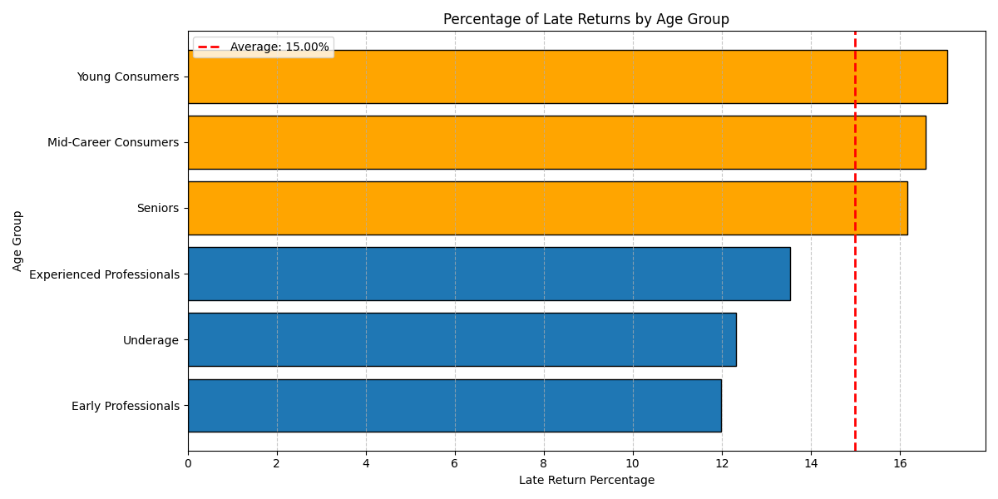
Some age groups hold onto books longer than others
This is reflected both in the number and the rate (%) of late returns

Slide 6
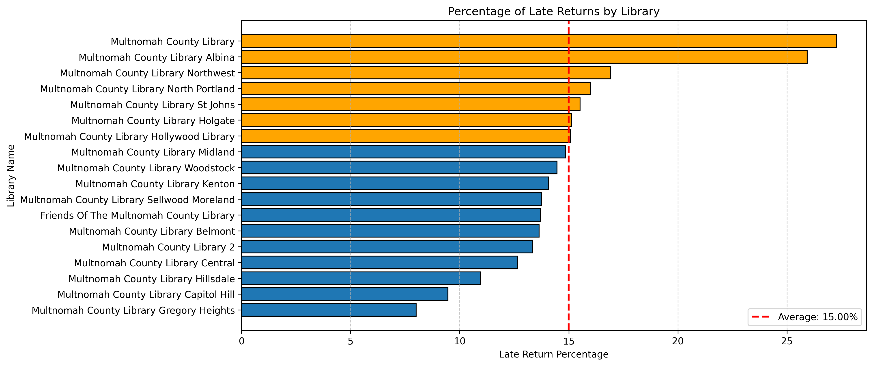
Some libraries have subpar return rate
Average rate of late returns is high but for some libraries it’s even higher

Slide 7
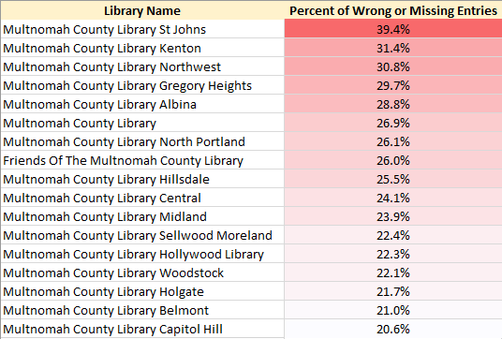
Libraries data quality can be improved
Third of all data entries in libraries have issues with checkout and return dates
Even more have additional issues with client data, book data, etc.

Slide 8
Multiple options are available to remedy late returns
Adjust Loan Periods Based on Book Length
Allow longer borrowing periods for books over a certain page count
Provide Return Flexibility
Consider an automatic extension if no one else has placed a hold on the book
Implement a drop-off or pick-up service for people who have mobility challenges
Offer Incentives for On-Time Returns
Reward consistent on-time returns with small perks (e.g., fine waivers, early access to new books)
Implement Gentle Reminders & Notifications
Send early reminders via email, text, or phone a few days before the due date

Slide 9
Enhance User Experience by Improving Data Quality
Automate Data Collection
Use barcode scanners or RFID systems for book checkouts and returns instead of manual input
Automate overdue tracking and reminders
Collect Feedback and Monitor Data Usage
Allow patrons to report errors (e.g., incorrect book detail)
Train Library Staff on Data Quality Best Practices
Provide training session on accurate data entry and the importance of data integrity
Implement Regular Inventory Checks
Schedule routine checks to remove duplicate, outdated, or incorrect records
Setup error detection that flag missing fields

Slide 10
Grow Trust and Build More Efficient Operations
Effects of proposed measures:
Short-Term: Immediate improvements in return rates and data accuracy
Mid-Term: More efficient operations, growing trust and more satisfied customers
Long-Term: Beloved, community-trusted library with modern and higly efficient operations

